Slide 1

Prof. Beverley Hawkins
Leading Yourself
Reflecting on your own Leadership Practices

Slide 2
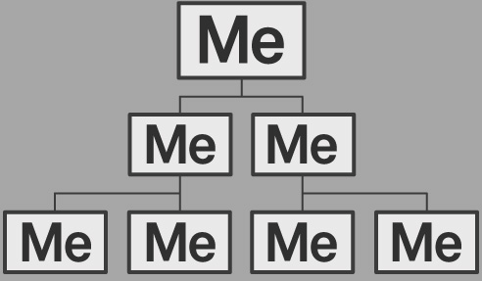
Learning Outcomes
This session will help you to
Understand why any leadership challenge starts with leading YOURSELF
Think about how you lead yourself in response to challenges
Provide you with a range of ways to explore your self-leadership

Slide 3

What is self leadership?
Leading ourselves is an integral part of responding to any challenge and leading others.

Slide 4
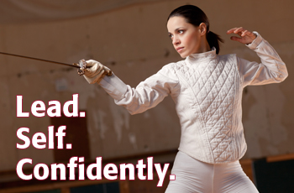
Any time you respond to a challenge…whether it is a personal one, or a collaborative one…. You are engaging in self-leadership.
Deciding what to do
Regulating your actions to make them fit the challenge, the context, and the people you work with
Developing yourself and others
Learning how to ‘do it better’
“the process of becoming a leader is much the same as that of becoming an integrated human being”. Warren Bennis, (1989)

Slide 5
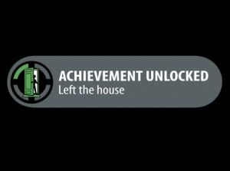
What is self-leadership?
‘Self leadership is a self-influence process through which people achieve the self-direction and self-motivation necessary to perform’ Neck and Houghton (2006: 271)
‘a self-influence process and set of strategies that primarily address how work is performed to help meet standards and objectives that are typically externally set . . . [it] tends to rely on extrinsic motivation and to focus on behaviour. (Manz 1991 p. 17 in Stewart, Courtright and Manz 2011: 188)

Slide 6

University:
Improving your grades
Setting a study routine
Getting started in a
new academic culture
Lifestyle:
Getting fitter and healthier
Stopping smoking
Joining a sports club, Learning a new skill
Team:
Being part of a club or team
Helping others to reach their goals
Self leadership
YOUR experiences?
Social
Making new friends
Immersing yourself in new social challenges
Work:
Working towards targets
Improving relationships with colleagues

Slide 7
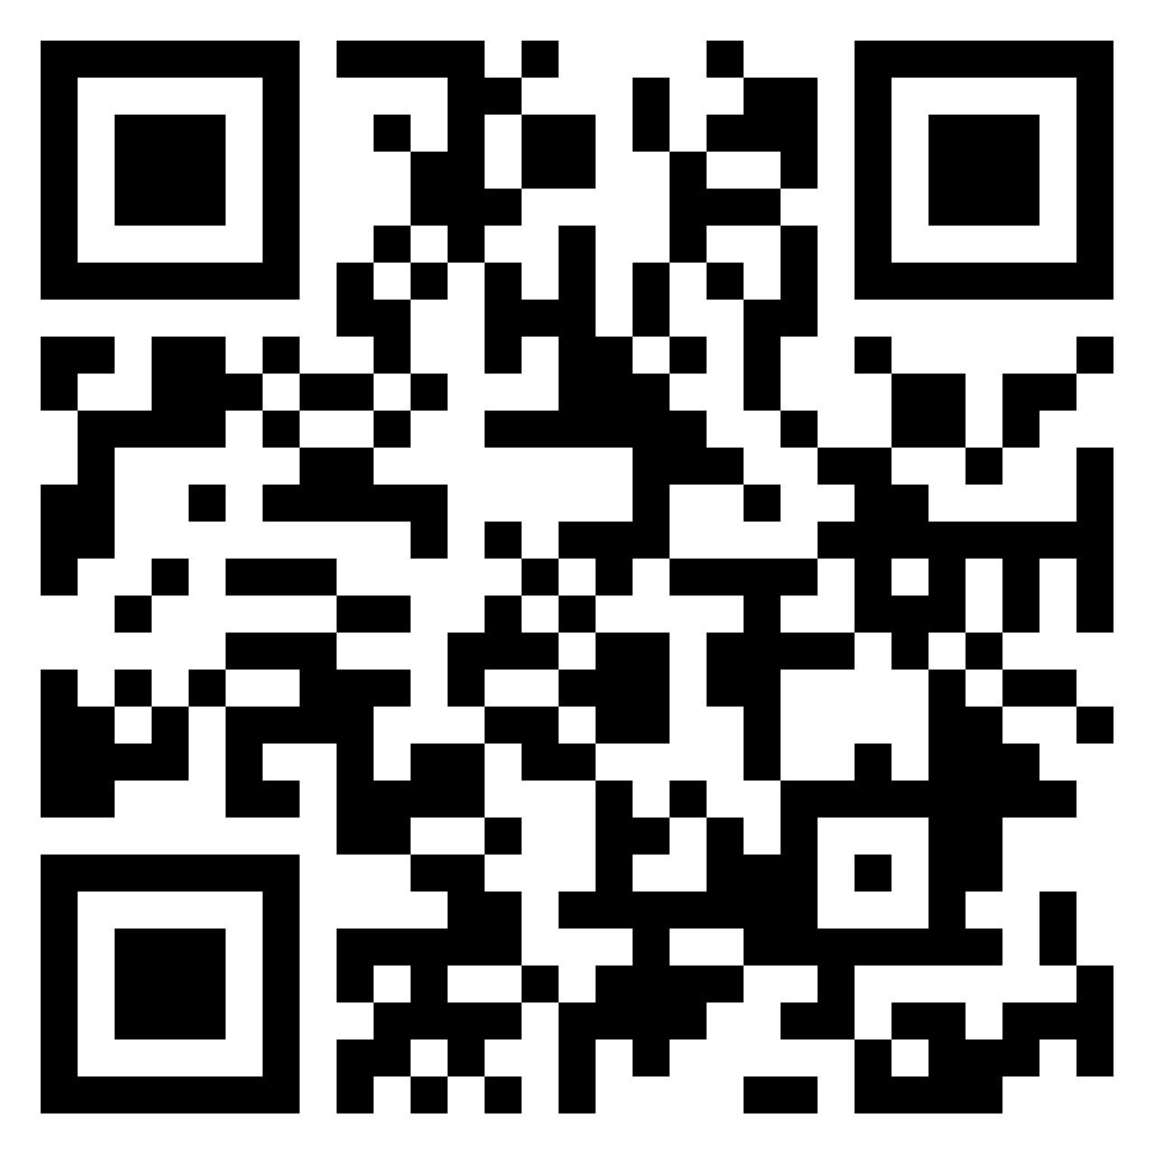
Your self leadership?
Padlet:
https://exeter.padlet.org/bchawkins/2023-09-29-your-self-leadership-examples-bohj05i53w4bht5v

Slide 8
The Principles of Self-Leadership WHAT, HOW, WHY?
Cognitive (thinking) and behavioural (practice) techniques
address the WHAT, HOW and WHY of our task (Stewart, Courtright and Manz 2011)
WHAT should I do? = goal setting
HOW should I do it? = self regulation
WHY should I do it = self motivation.
These techniques are thought to lead to success in the workplace AND the classroom (Napiersky and Woods 2016)

Slide 9
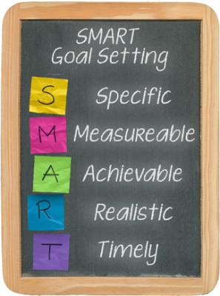
What? Goal Setting Techniques
I will apply for lots of jobs ✖
Too Vague
Not measurable
Not achievable or realistic
No deadline!
By DATE XXXX
I will identify the career field I am interested in and I will complete and send off TEN job applications ✔
High achievers are different because...
...they set and REVIEW their goals regularly (Grant 2011)

Slide 10
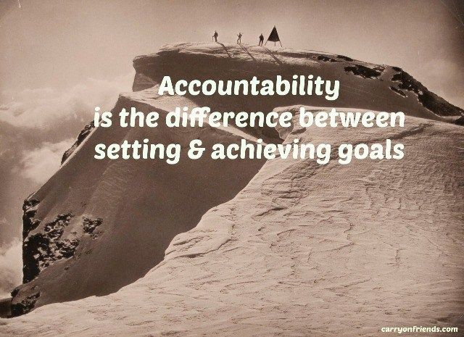
Goal setting is a self-leadership tool because
it keeps you on track
it develops your ability to reflect on your actions
most effective when someone else holds you accountable
who holds YOU accountable in your life?
Travers, C. J., Morisano, D., & Locke, E. A. (2015). Self‐reflection, growth goals, and academic outcomes: A qualitative study. British Journal of Educational Psychology, 85(2), 224-241.

Slide 11
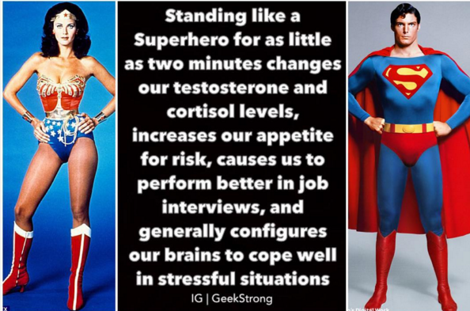
How? Self Regulation Techniques
Managing our thought patterns
e.g.
Constructive Self Talk
‘Power poses’
Mental imagery
Routinising positive behaviours
e.g. Timetabled activities
Emotion Regulation
e.g. Altering work to increase enjoyment levels
Stewart, Courtright and Manz 2011

Slide 12
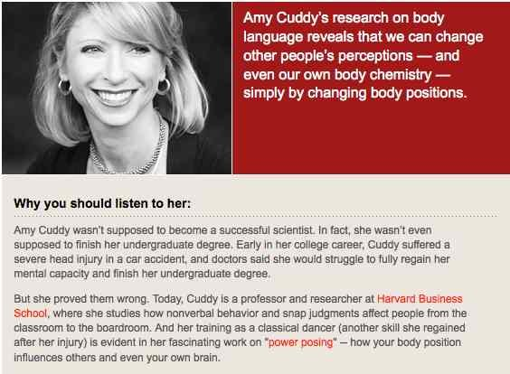
Amy Cuddy’s ‘Power Poses’ https://www.youtube.com/watch?v=Ks-_Mh1QhMc
Do you agree with this perspective? Are there any problems associated with Amy’s ideas?

Slide 13
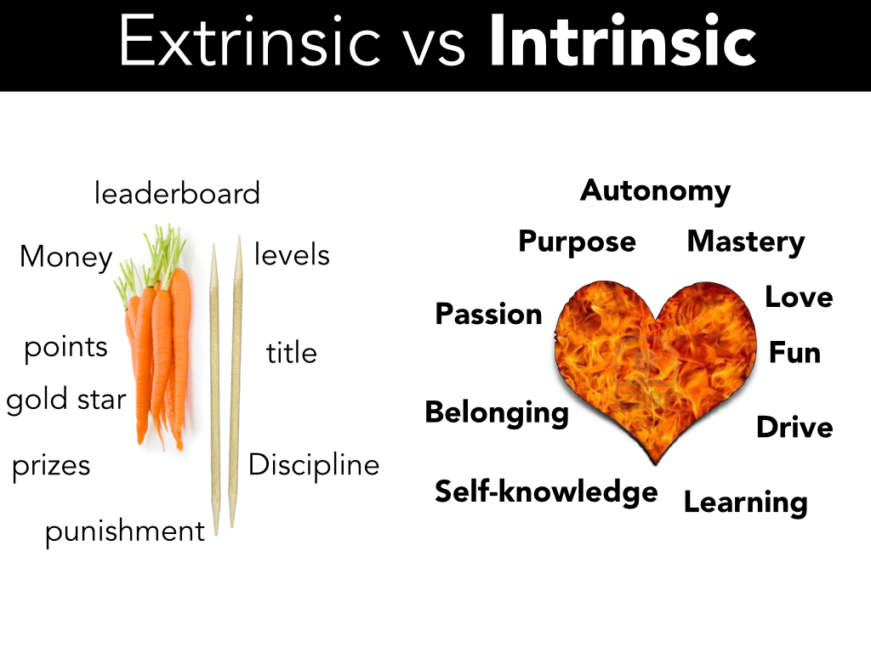
Why? Motivation Techniques
Intrinsic Rewards: the work is intrinsically satisfying because it fits with our sense of self purpose, gives us a sense of progress or is in another way meaningful to us.
External Rewards: the work is rewarding because we are paid/get external recognition / we receive a high grade
Stewart, Courtright and
Manz (2011)
What motivates YOU?

Slide 14

How do we get good at self leadership?
Self observation is a key part
Step 1: KNOW YOURSELF
What are your strengths? Your weaknesses? Your priorities in life?
Step 2: LEARN FROM YOUR MISTAKES
Mistakes are much more valuable than successes in self-leadership!
They can help us learn and develop alternative courses of action

Slide 15




Experiential learning cycle
Concrete experience
Immersing yourself in the task
Active experimentation
What will happen next?
Reflective observation
What did you notice?
Abstract conceptualisation
What does it mean?
Kolb, 1984
Notes:
Kolb’s theory of experiential learning:
Relevant to learning about leadership practice:
Why is critical reflection necessary?
Because via experience
we have the opportunity to critically reflect
which allows us to question our ‘common sense’ assumptions about how we should do something
which tells us what we could try out next
Key to the way this module works
Also a key practice in responding to leadership challenges.

Slide 16

Self-leadership does not come about through force of will or strength of character alone
Evidence suggests that leaders create change only when the context is receptive to that change
Therefore self-leaders require an awareness of context
How do you make sense of the world around you?
How do others make sense of things?

Slide 17
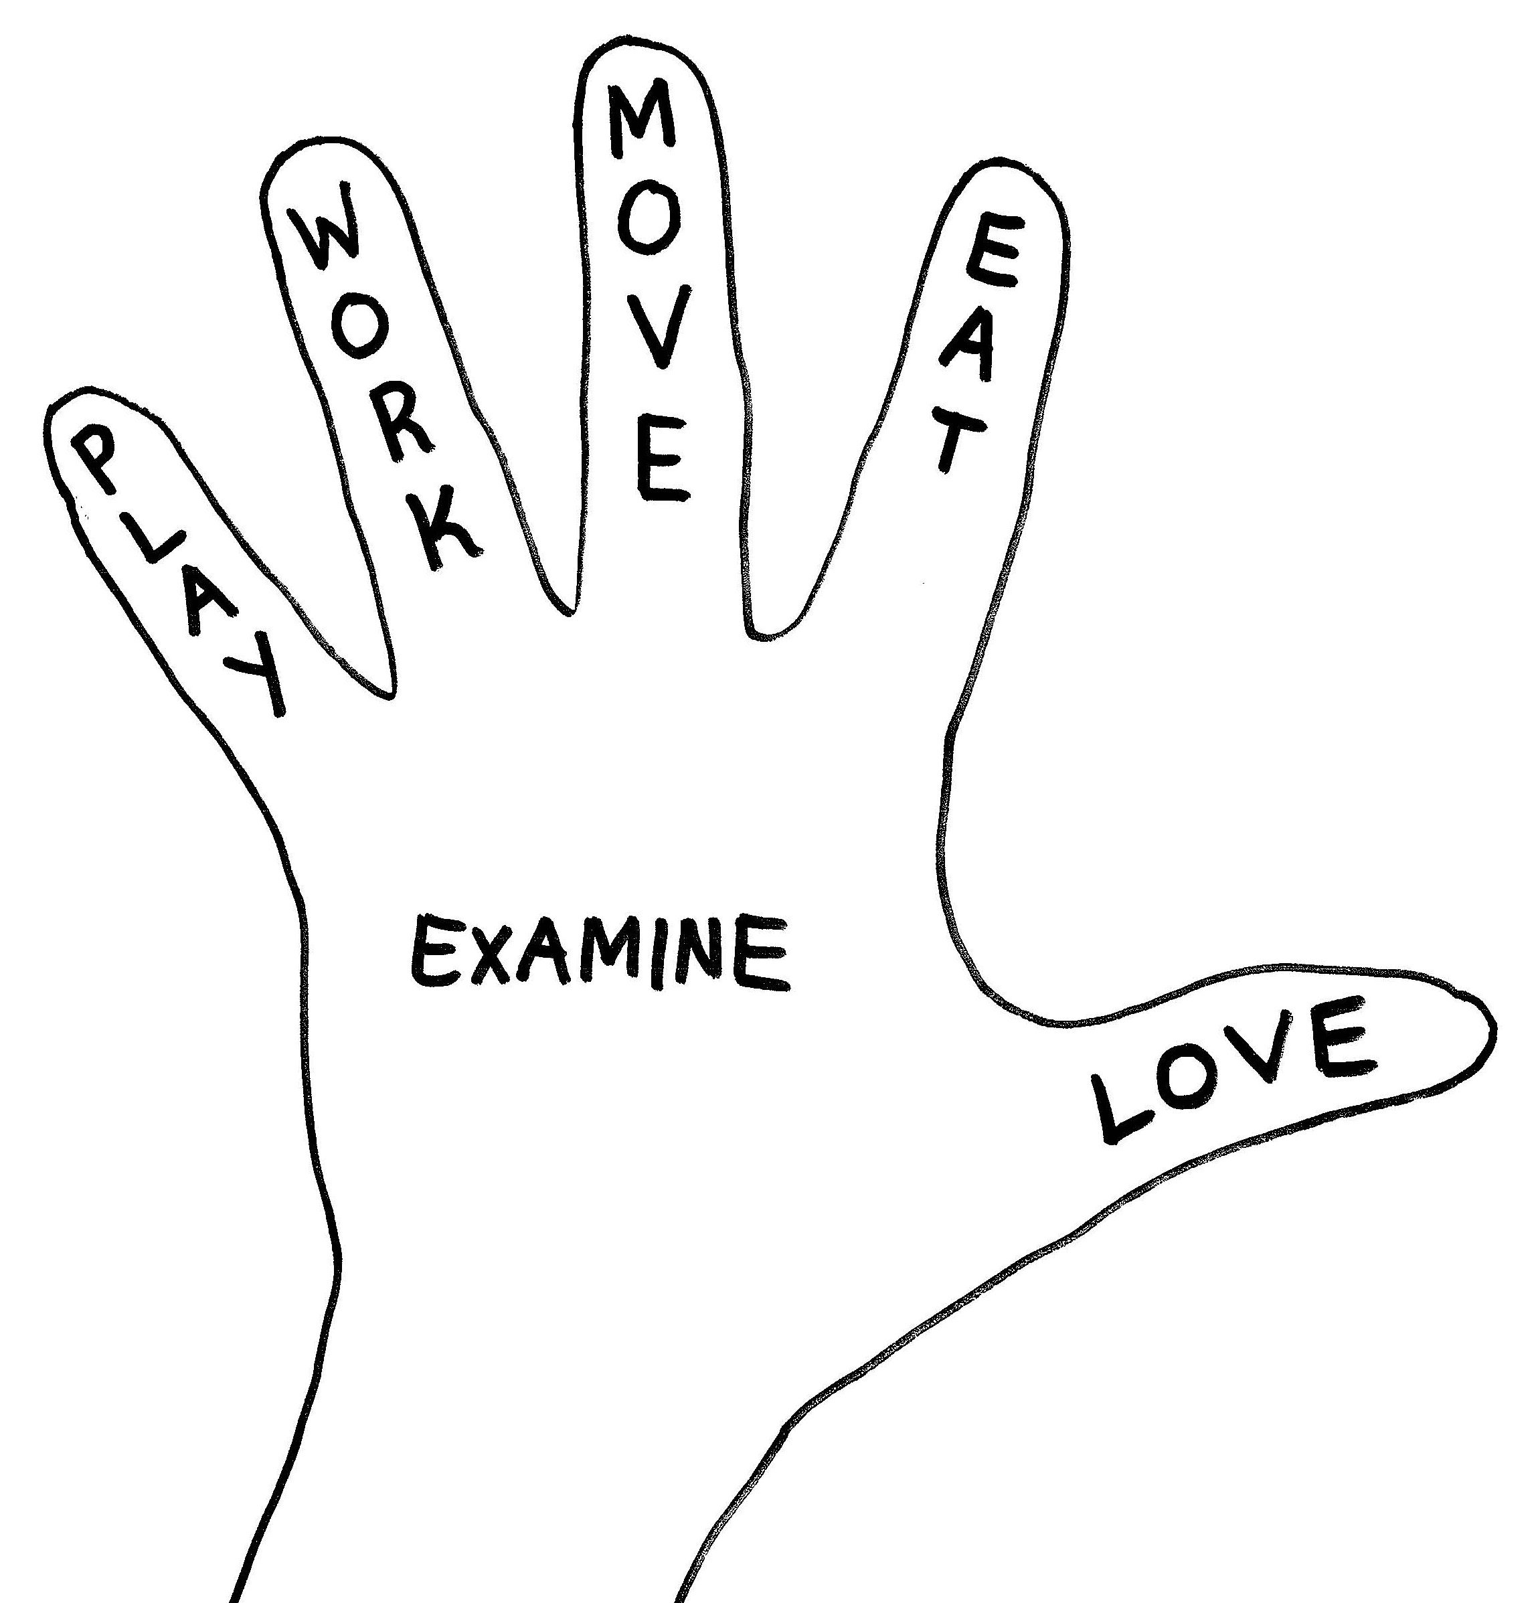
What does this mean for self-leadership?
We need to understand ourselves...
Your purpose and values
Your personal frame of reference – how do you see and make sense of the world?
How do you learn best?
Your best attributes?
The attributes you need to work on?
We need an awareness of how others see us
We need an awareness of the context in which we are embedded
What does society value?

Slide 18
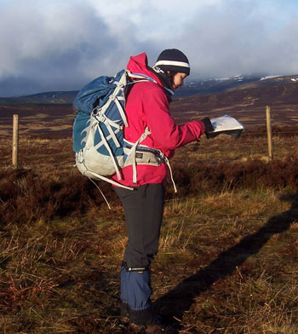
ALL Leadership involves ‘sense-making’
People make sense of their actions by reflecting on them
Only then can they explain what those actions mean
They will use this meaning as a basis for deciding on future action
This process of sense-making has an impact on deciding the directions we take, and how we get there.
According to Weick (1995), leadership through sense-making is like navigating.
Karl Weick (1995 ‘Sensemaking in Organizations’)

Slide 19
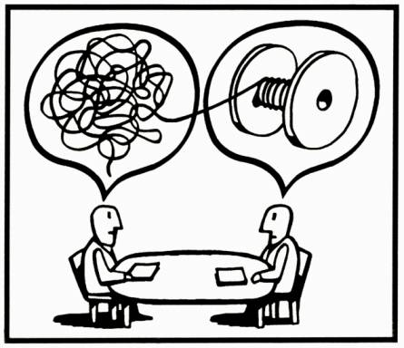
Sensemaking is how we create order from life’s complexity

Slide 20
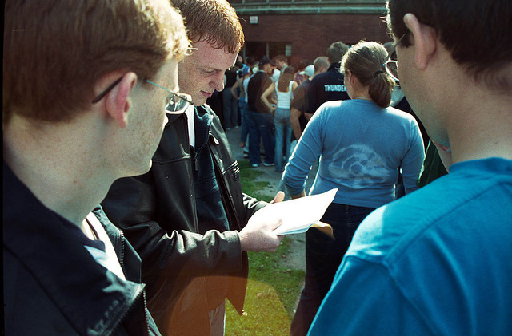
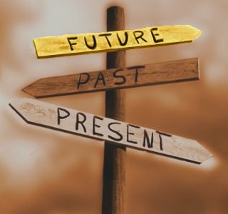
How do we use sense-making?
Sense-making is a collaborative, social process which helps us to co-create shared meaning about events
Example: After an exam, you discuss with your friends how the exam went
This is a sense-making process
It helps you decide how you will ‘see’ the exam.
On this basis, you make more decisions about what to do next (e.g. whether to work harder next time)
Sense-making is an iterative way of moving between past, present and future.

Slide 21
Important Sensemaking Concepts (Weick 1995)
Cues: events, memories and other parts that we isolate from our stream of experience, and recognise as being ‘important’ in some way.
Bracketing: the practice of isolating ‘cues’ from the rest of our stream of experience.
Frames
The way we understand our experiences is shaped by one or more frame – a mindset, a political economy, an ideology or set of social assumptions.
Frames can affect which cues we bracket as being important in our decision-making.

Slide 22
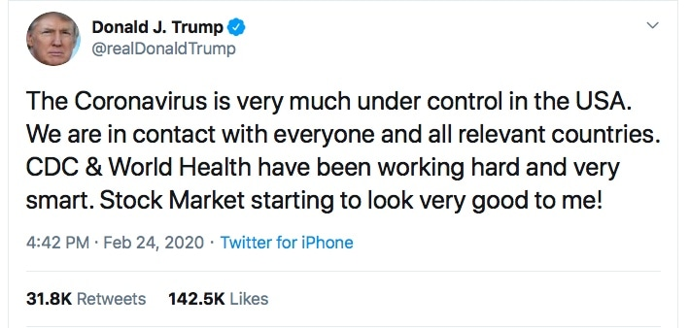
Leaders try to ‘frame’ our sensemaking so that we understand things in new ways.

Slide 23
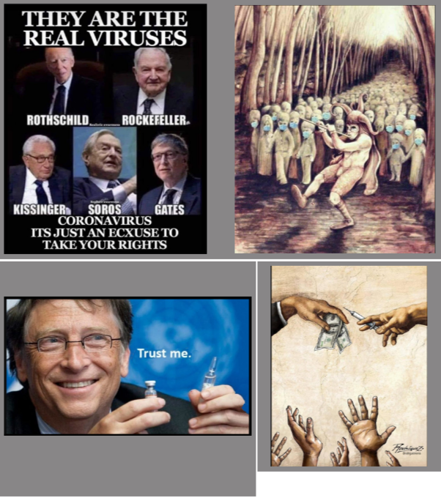

Slide 24
Seven properties of Sensemaking (Weick 1995)
Related to our identity. Our understandings of reality are connected to our understanding of ourselves as individuals.
A retrospective process – we develop understandings about what to do in the present, by picking out important aspects from our stream of past experiences.
An active process – understandings are constructed and enacted, not passively absorbed.
A collective process. We create our social environments and justify our decisions by sharing ideas, and by learning about and passing on social conventions and expectations.

Slide 25
Seven properties of Sensemaking (Weick 1995)
5) Continuous – people shape and react to their environment.
6) Based on the extraction of cues from the environment
7) Focused on plausibility, not accuracy (Weick 1995)
Sensemaking not just an internal mental or cognitive process. It is affected by our social relationships, our emotions and our physical responses (Cunliffe and Coupland 2012).
We always ‘make sense’ (construct reality) of unknown things together.
Consequence: Our self-leadership actions take place through this social process - they are shaped by shared understandings and expectations.

Slide 26
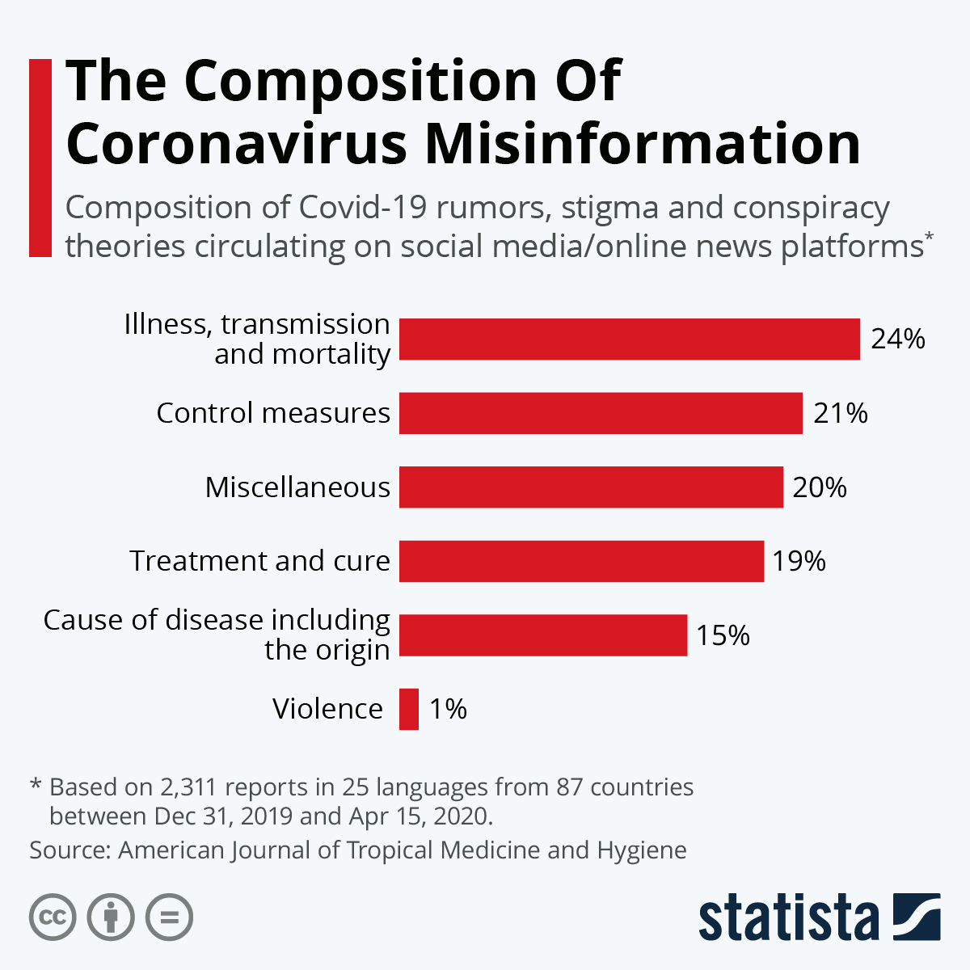
Plausibility over Accuracy can result in ‘Fake News’...but it’s how we learn to make sense of the world.
Does this help or hinder our ‘self leadership’ actions?

Slide 27
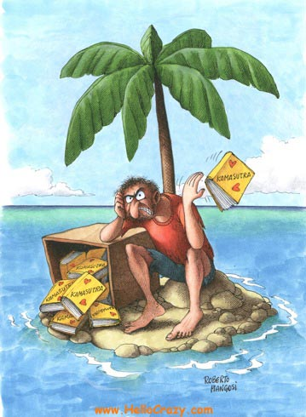
What does sensemaking tell us about the limits of self-leadership?
Our actions take place within the social realm
They have impact, but:
..we are not all-powerful!
Our ability to act is enabled and constrained by the social relationships in which we are embedded.
Any decision can have unintended consequences.
No man is an island…..

Slide 28

The pressures of self-leadership
https://youtu.be/2paoNvG5Nmo
Millennials are statistically the generation most interested in self-improvement...
..and the generation most likely to experience burnout.. (https://www.gallup.com/workplace/237377/millennials-burning.aspx )
Is ‘being succesful’ more important than happiness or contentment?

Slide 29
References
Alvesson, M., & Willmott, H. (2002). Identity regulation as organizational control: Producing the appropriate individual. Journal of Management Studies, 39(5), 619–644.
Brown, A.D., Colville, I., & Pye, A. (2015). Making sense of sensemaking in organizational studies. Organization Studies, 36(2), 265–277.
Cunliffe, A., L., & Coupland, C. (2012). From hero to villain to hero: Making experience sensible through embodied narrative sensemaking. Human Relations, 65(1), 63–88.
Grant, H. (2011, February 25). Nine things successful people do differently. HBR.org. https://hbr.org/2011/02/nine-things-successful-people
Grey, C. (1994). Career as a project of the self and labour process discipline. Sociology ,28(2), 479–497
Helms Mills, J., Thurlow, A., & Mills, A. J. (2010). Making sense of sensemaking: The critical sensemaking approach. Qualitative Research in Organizations and Management: An International Journal, 5(2), 182–195.
Holt, R., & Cornelissen, J. (2014). Sensemaking revisited. Management Learning, 45(5), 525–539.
Houghton, J. D., Wu, J., Godwin, J. L., Neck, C. P., & Manz, C. C. (2012). Effective stress management: A model of emotional intelligence, self-leadership, and student stress coping. Journal of Management Education, 36(2), 220–238.
Manz, C. C. (1986). Self-leadership: Toward an expanded theory of self-influence processes. Academy of Management Review, 11(3), 585–600. https://doi.org/10.5465/amr.1986.4306232
Marques-Quinteiro, P., & Curral, L. A. (2012). Goal orientation and work role performance: Predicting adaptive and proactive work role performance through self-leadership strategies. The Journal of Psychology, 146(6), 559–577.

Slide 30
Napiersky, U., & Woods, S. A. (2016). From the workplace to the classroom: Examining the impact of self-leadership learning strategies on higher educational attainment and success. Innovations in Education and Teaching International, 1–9. https://doi.org/10.1080/14703297.2016.1263232
Neck, C. P., & Houghton, J. D. (2006). Two decades of self-leadership theory and research: Past developments, present trends, and future possibilities. Journal of Managerial Psychology, 21(4), 270–295
Pye, A. (2005). Leadership and organizing: Sensemaking in action. Leadership, 1(1), 31–49. https://doi.org/10.1177/1742715005049349
Stewart, G. L., Courtright, S. H., & Manz, C. C. (2011). Self-leadership: A multilevel review. Journal of Management, 37(1), 185–222.
Weick, K. E., Sutcliffe, K. M., & Obstfeld, D. (2005). Organizing and the process of sensemaking. Organization Science, 16(4), 409–421.

